Slide 1

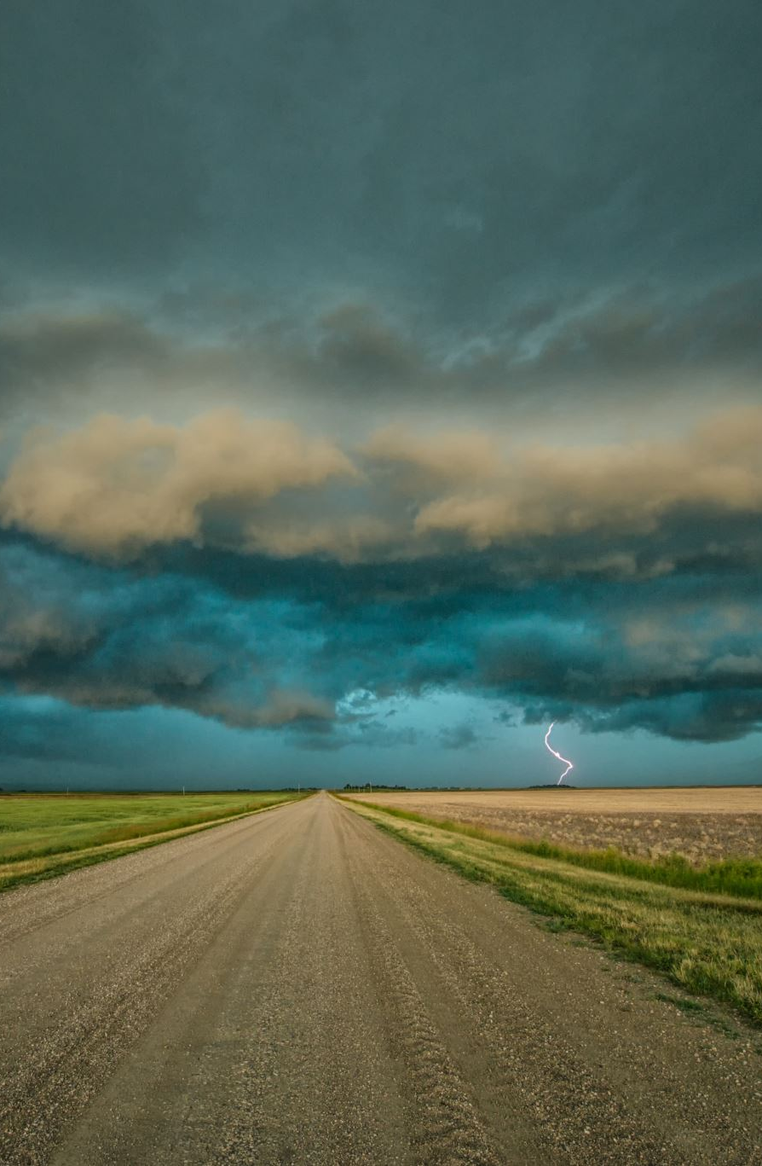
Weather Image Recognition
Ajay Shrikrishna Naik, Umutbek Abdimanan Uulu, Serkan Hiziroglu,
Hema Deepika Thanigai Arasu, Vu Pham

Slide 2
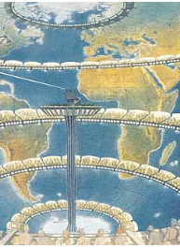




Background and Problem Statement
U.S adults check weather forecasts 300 billion times a year (Lazo et al., 2009)
Weather prediction points to Lewis Fry Richardson in 1922
Numerical weather prediction (NWP) v. deep learning weather prediction (DLWP)
Notes:
Reliable forecasts play a crucial role in the prediction of harzadous weather, such as flash floods, hurricanes, and blizzards, 9 to 10 days before their occurrence.
The history of weather forecasting points to 1922 when Britain’s Lewis Fry Richardson constructed a systematic process based on math to help predict weather
While deep learning weather prediction (DLWP) models do not currently rival NWP, the machine learning approach shows promise.

Slide 3
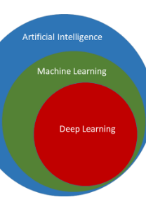
Purpose of Project
Predicting good or bad weather
Comparing the accuracy of three models:
Support Vector Classifier (SVC),
Decision Tree, and
Convolutional Neural Network (CNN)
Notes:
In this project, we design to train three model to predict weather is good or bad.
Three models will be trained, first model will be train using Support Vector Classifier (SVC), second model will be train using Decision Tree and third model will be train using Convolutional Neural Network (CNN) which will detect weather is good or bad.

Slide 4
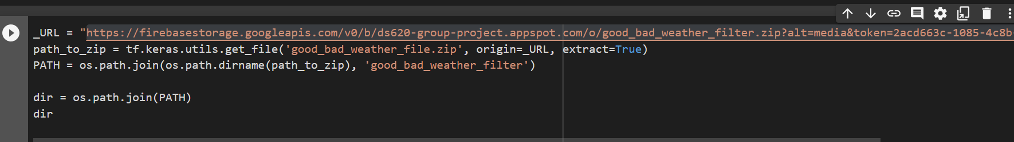
SVC and Decision Tree Dataset
200 randomly collected good weather images
200 randomly collected bad weather images
Data obtained from Kaggle
Code Snippet shown below
Notes:
Our dataset has 6862 weather images in 11 different weather categories.
To prepare for SVC dataset we have currently we have gathered some random 200 good images of dew, sunshine, rainbow and 200 bad images of snow, rain, and fog.

Slide 5
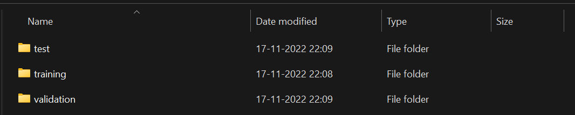
CNN Dataset
Same dataset used
Dataset distributed into three folders:
Training 70%
Validation 15%
Testing 15%

Slide 6
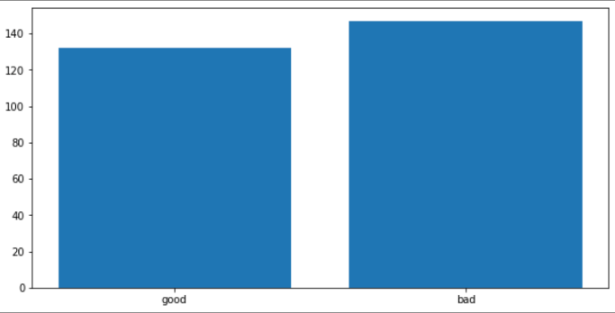
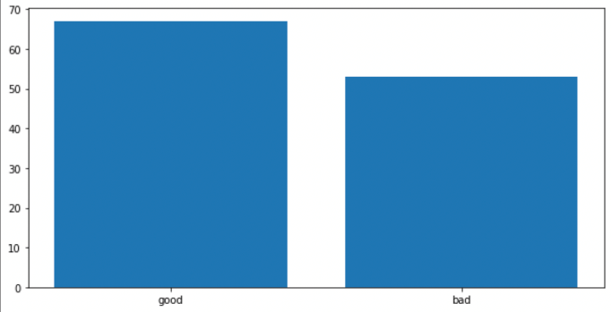
Preparing the model
Training set
train_test_split function splits data into:
Training set 70%
Test set 30%
Test set

Slide 7
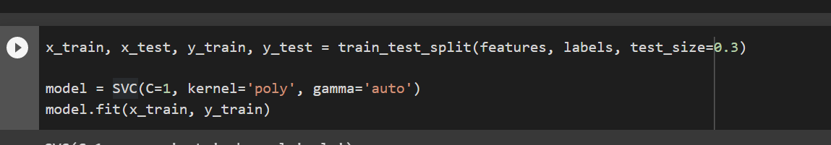
SVC Model Initialization
SVC model initialized with polynomial kernel with 1 regularization parameter and gamma value as auto
Model trained the model using the fit method.
Notes:
Support vector machines (SVMs) are a set of supervised learning methods used for classification, regression and outliers’ detection.
SVC works by mapping data points to a high-dimensional space and then finding the optimal hyperplane that divides the data into two classes

Slide 8
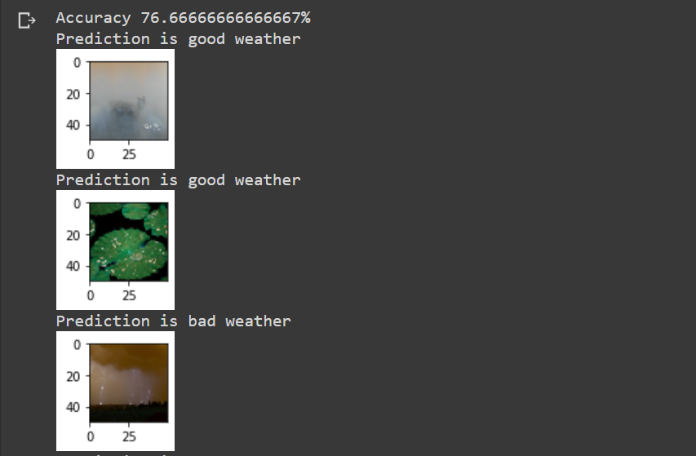
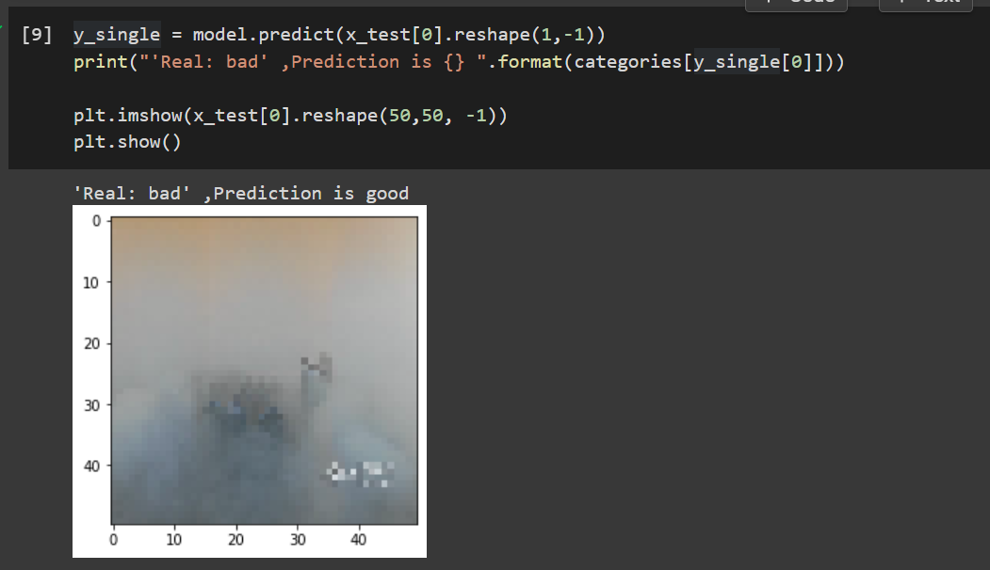
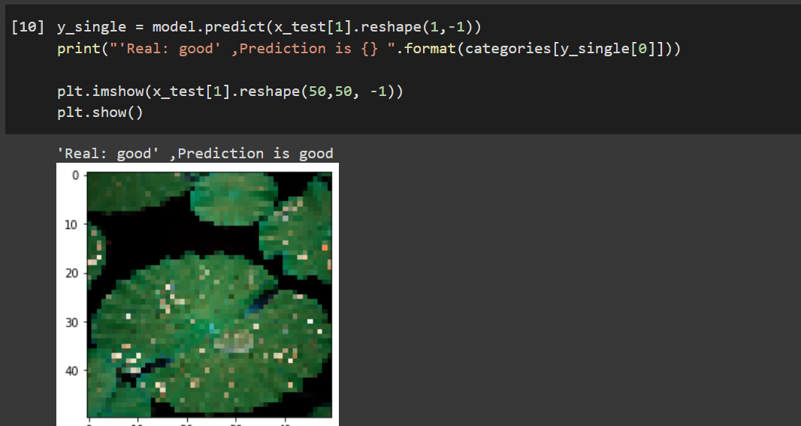
Evaluating SVC Model
Predicted v Actual Output
The model is 76% accurate
The MSE is quite high with a 49% score. We need to improve accuracy of the model.
Notes:
In Statistics, Mean Squared Error (MSE) is defined as Mean or Average of the square of the difference between actual and estimated values.

Slide 9
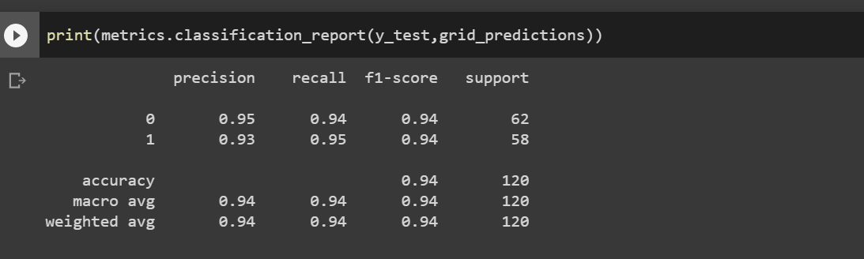
Improving the accuracy of SVC Model
Scikit-Learn’s K-Fold Cross-Validation feature used to improve the model
Training set is split into 10 folds
Model is trained and evaluated 10 times
Accuracy of the model is improved to 78%
RMSE is 0.5076684673359896 which is quite less compared to previous model
GridSearchCV was used to find the best params.

Slide 10
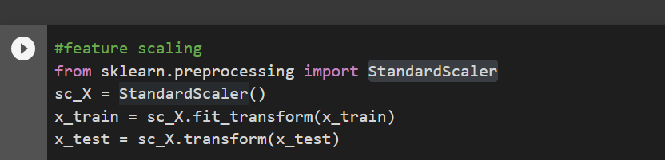
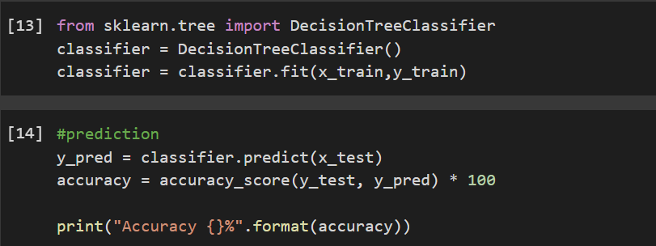
Decision Tree Model
Model accuracy is 68.33 % before fine tuning
Data preparation and splitting the code is similar as SVC.
Training and testing the decision tree is similar with SVC.

Slide 11
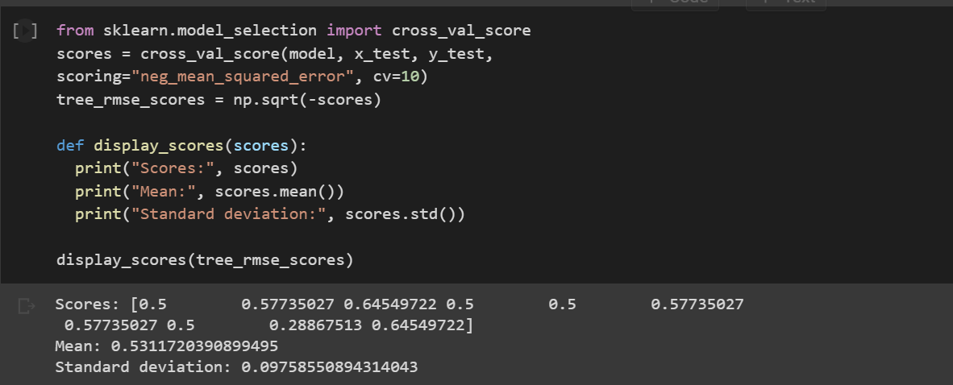
Improving Decision Tree Model Accuracy
GridSearchCV was used to find the best params.
Model accuracy is improved to 75%
Mean Square error was 0.57%.

Slide 12
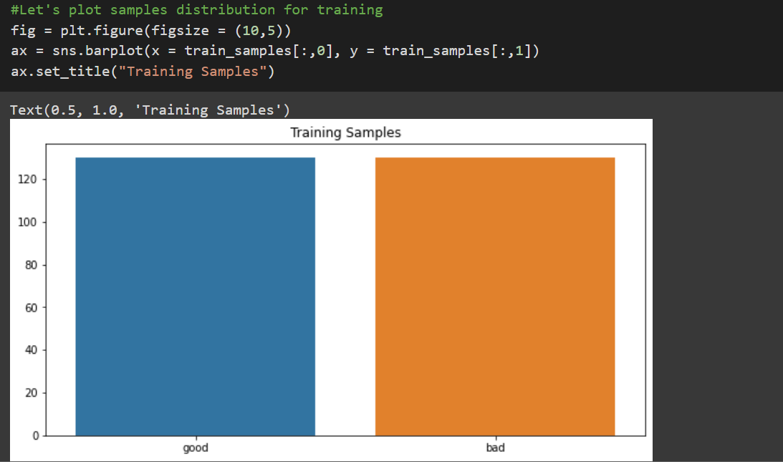
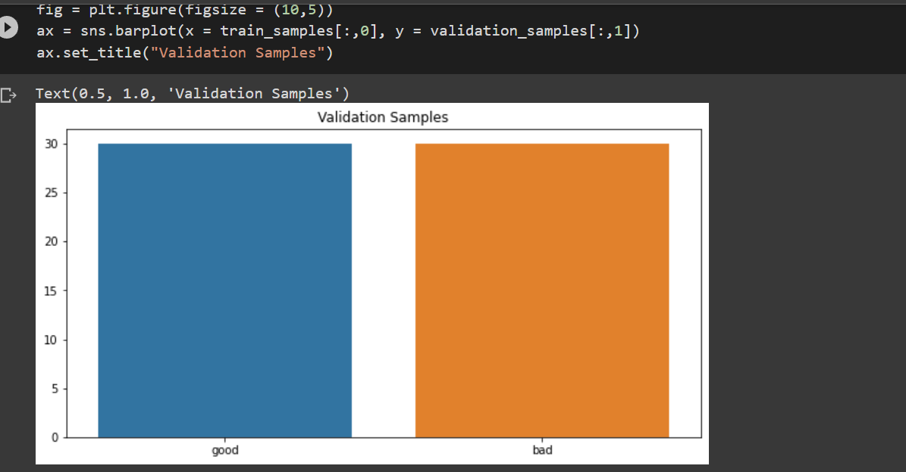
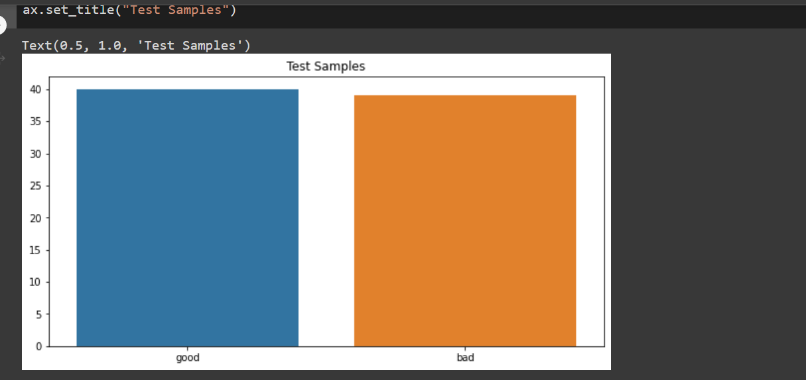
Convolutional Neural Network Model
Test Data
Validation data
Training data

Slide 13
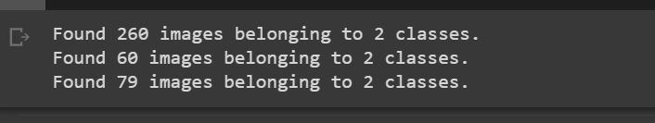
Image Processing and Data Augmentation
Images were augmented to prevent the model from seeing the same picture twice
Kera’s ImageDataGenerator was used
Notes:
ImageDataGenerator allows you to configure random transformations and normalization operations to be done on your image data during training. It also instantiates generators of augmented image batches (and their labels) via .flow(data, labels) or .flow_from_directory(directory). These generators can then be used with the Keras model methods that accept data generators as inputs, fit_generator, evaluate_generator and predict_generator.

Slide 14
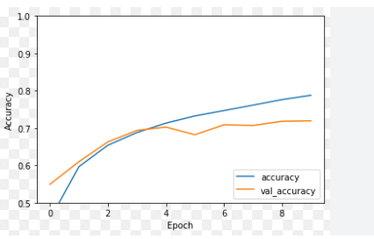
Improving CNN Accuracy
Increase the training dataset (Hasan et al., 2019)
Optimize filter size of the convolution layer and max-pooling of 512 by 512 images.
Use bimodal image enhancement

Slide 15
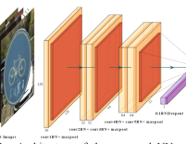
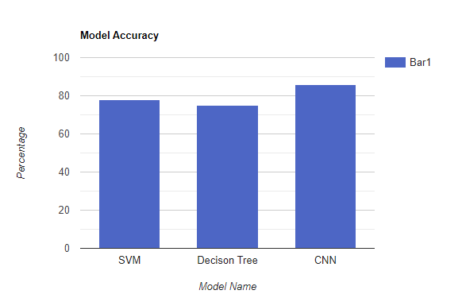
Comparing the Models
CNN is more accurate followed by SVC then Decisions tree
Wang et al. (2021) also found that CNN was more accurate for image classification

Slide 16

Conclusion
Machine learning models can be used to predict good and bad weather
Their accuracies differ
Focus on improving model accuracy

Slide 17
References
Hasan, M., Ullah, S., Khan, M. J., & Khurshid, K. (2019). Comparative analysis of SVM, ANN and CNN for classifying vegetation species using hyperspectral thermal infrared data. The International Archives of the Photogrammetry, Remote Sensing and Spatial Information Sciences, (pp. 1861-1868).
Lazo, J. K., Morss, R. C., & Demuth, J. L. (2009). Sources, perceptions, uses, and values of weather forecasts. Bulletin of the American Meteorological Society, 90(6), 785–798. doi:https://doi.org/10.1175/2008BAMS2604.1
Wang, P., Fan, E., & Wang, P. (2021). Comparative analysis of image classification algorithms based on traditional machine learning and deep learning. Pattern Recognition Letters, 141, 61-67. doi:https://doi.org/10.1016/j.patrec.2020.07.042

